Slide 1
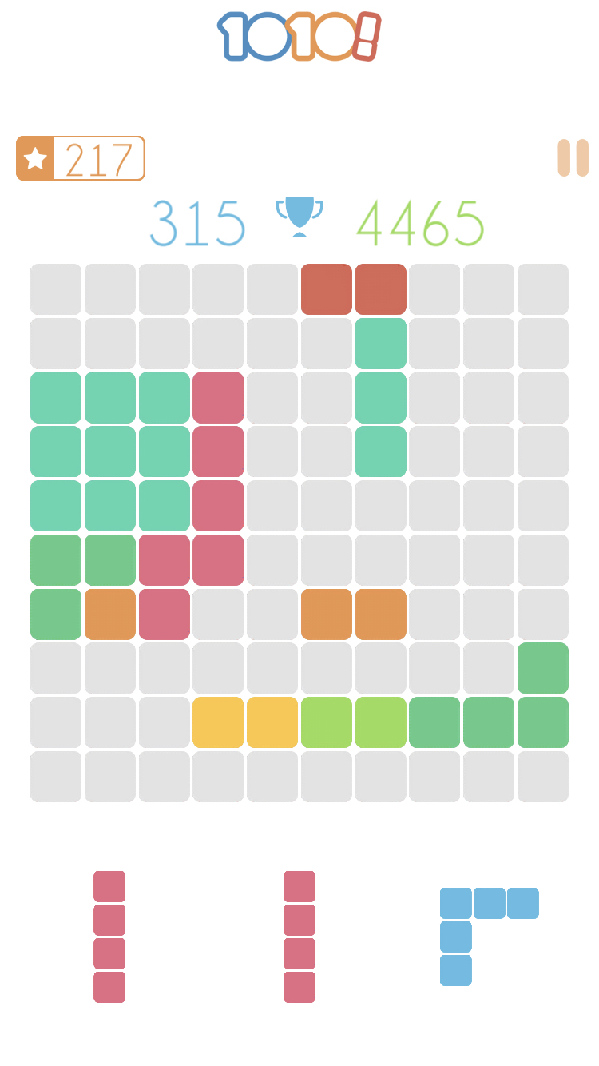
Rules of the game:
Every step of the game we receive 3 random pieces.
We should place these pieces one by one (no matter in which order) on the board. Every successfully placed piece increases the score and the goal is to achieve the highest score.
When the line or column is full, it disappears.
The game is over if you can’t place any of given pieces on the board (no free space).

Slide 2


Slide 3

HEURISTICS

Slide 4
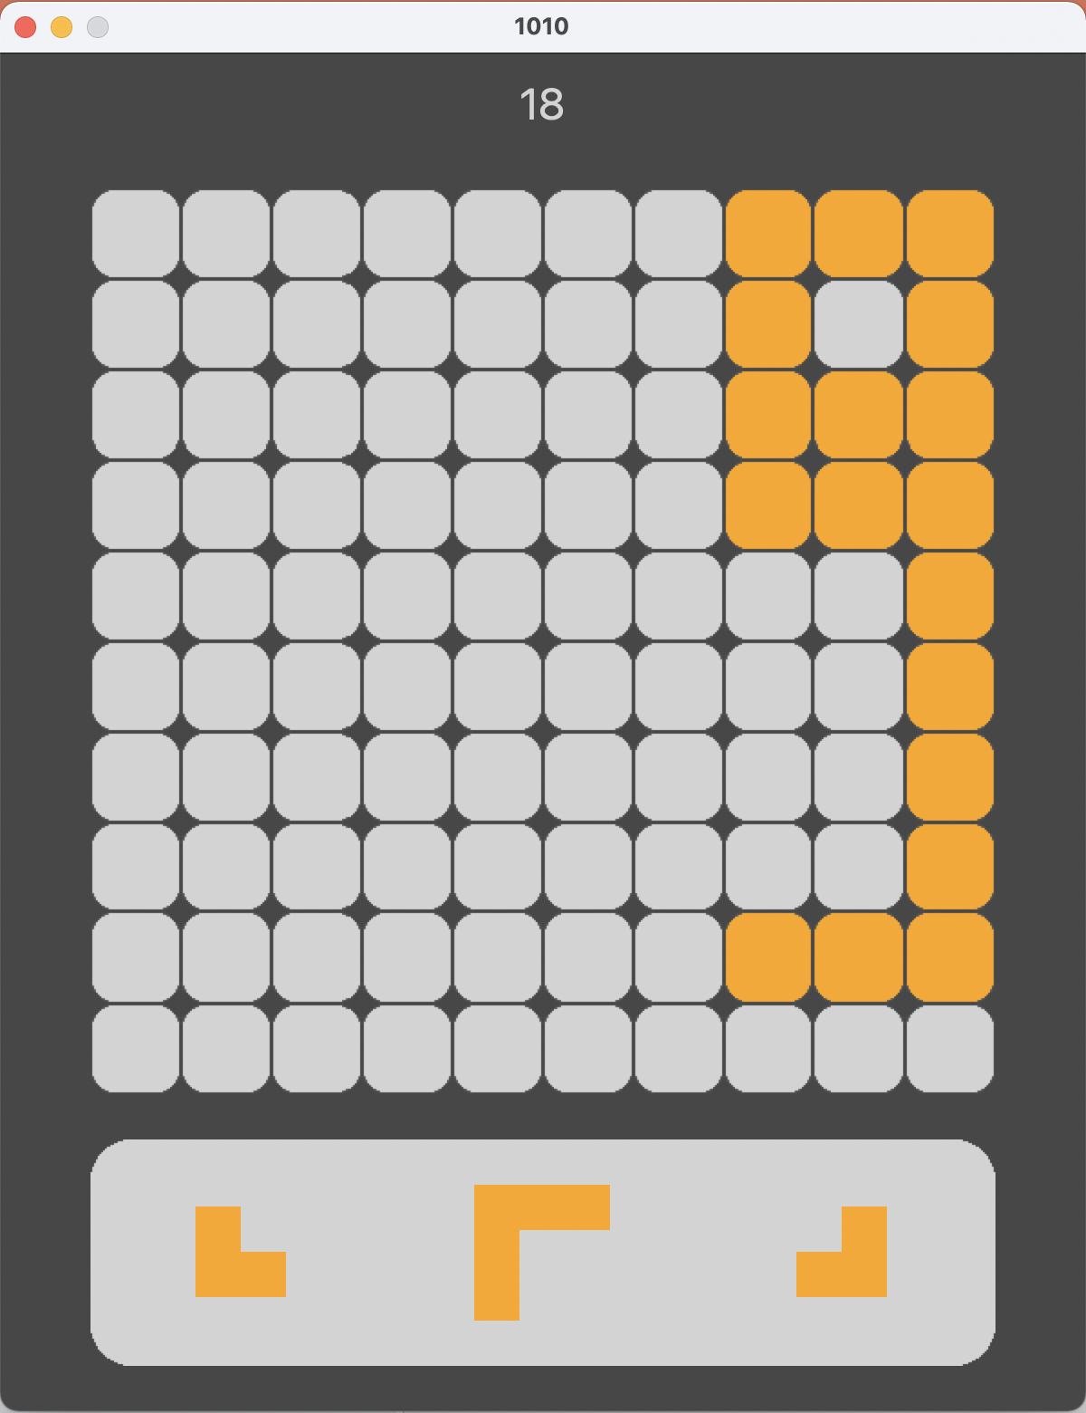

Slide 5
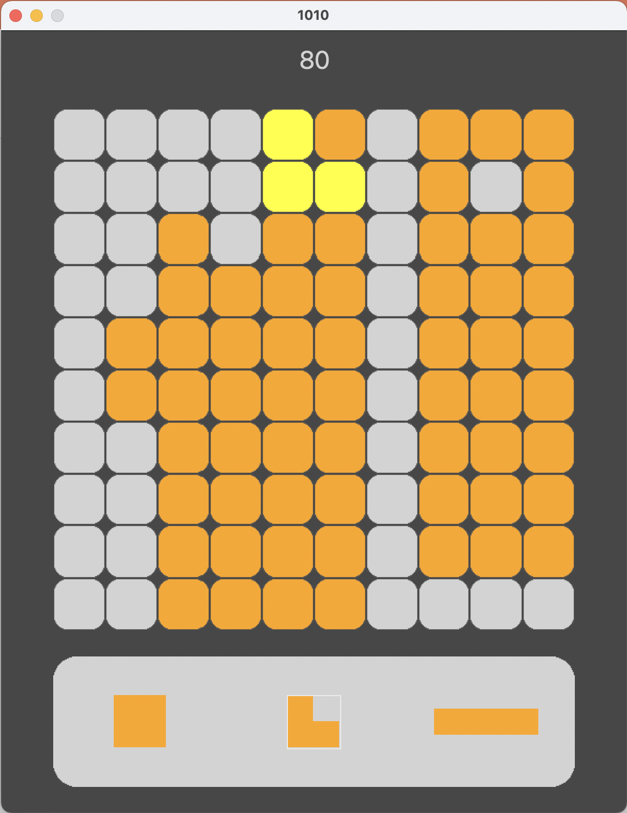
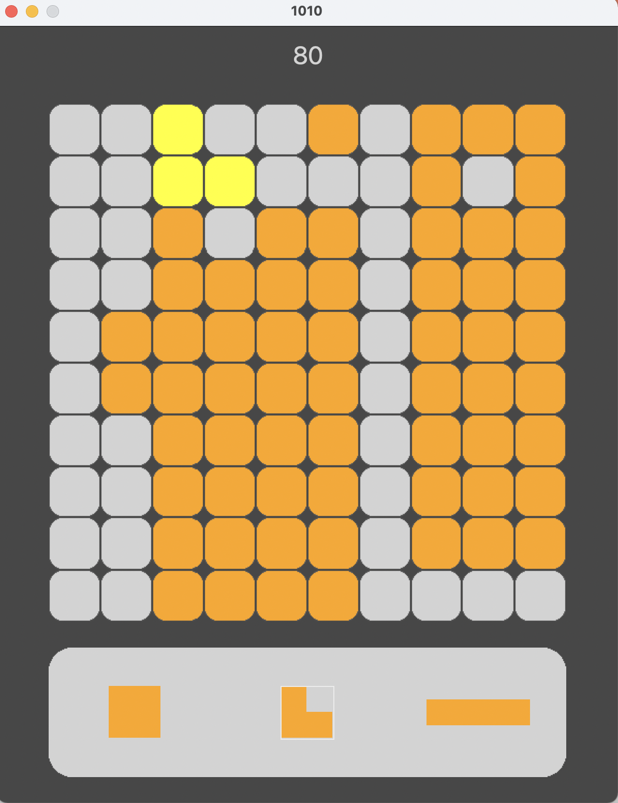

VS

Slide 6
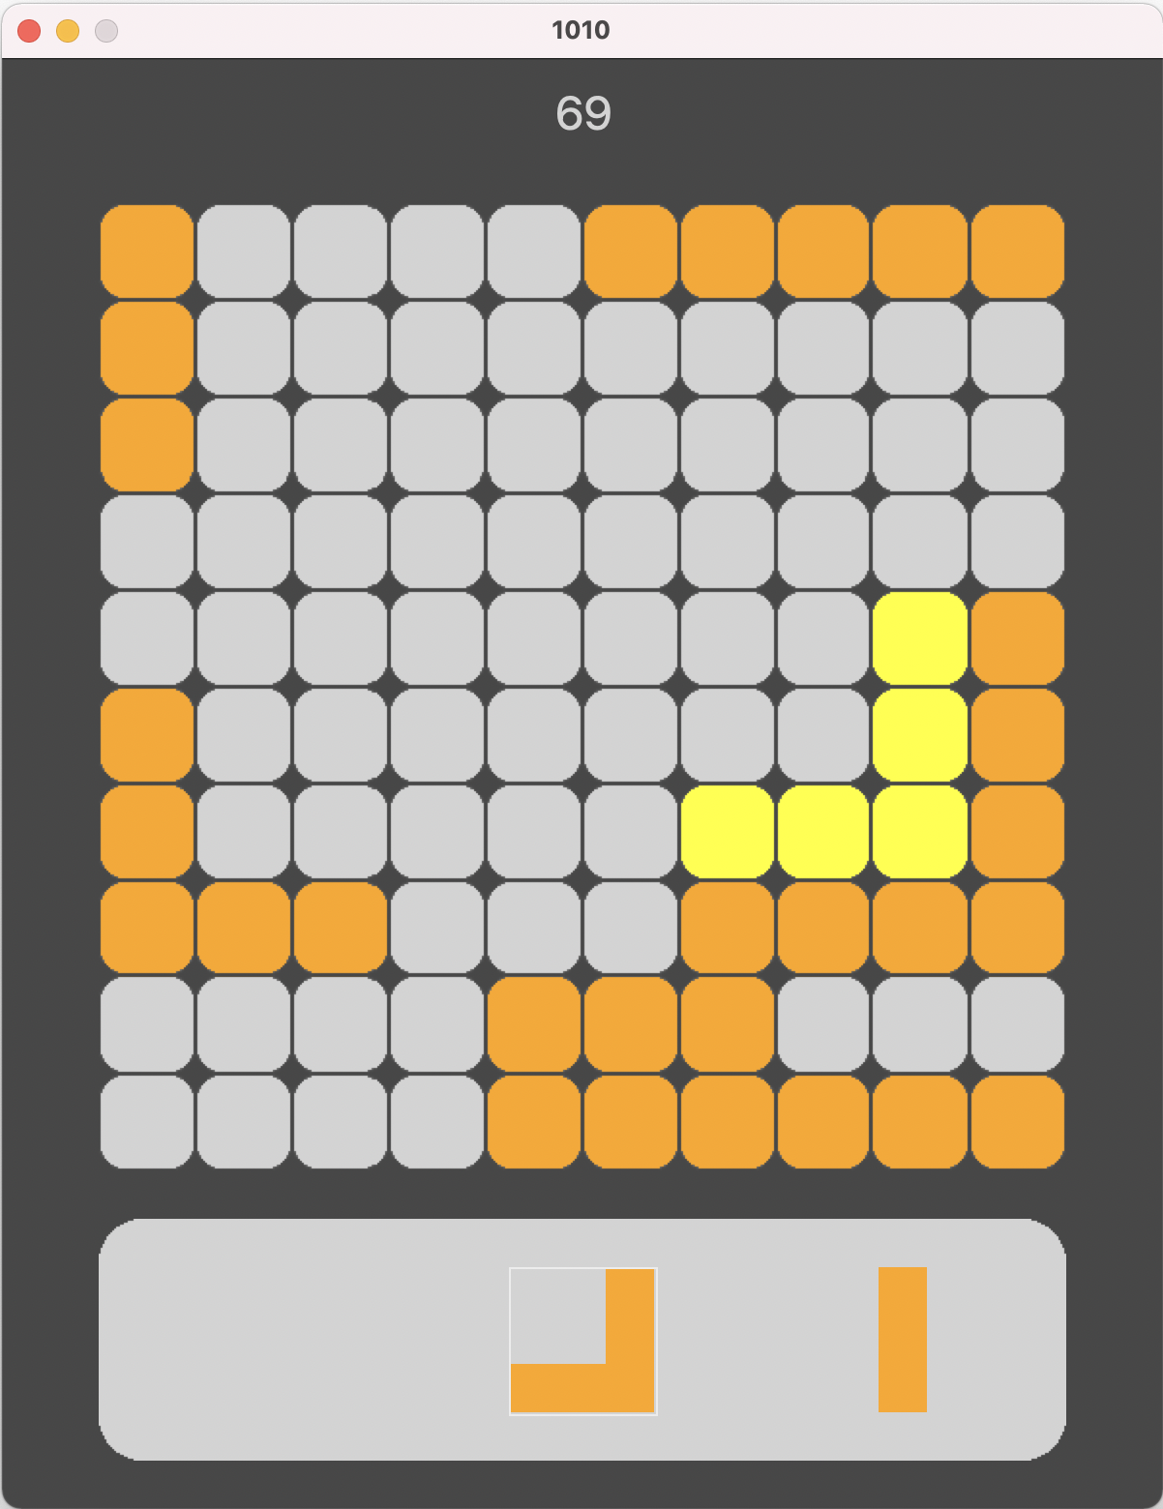
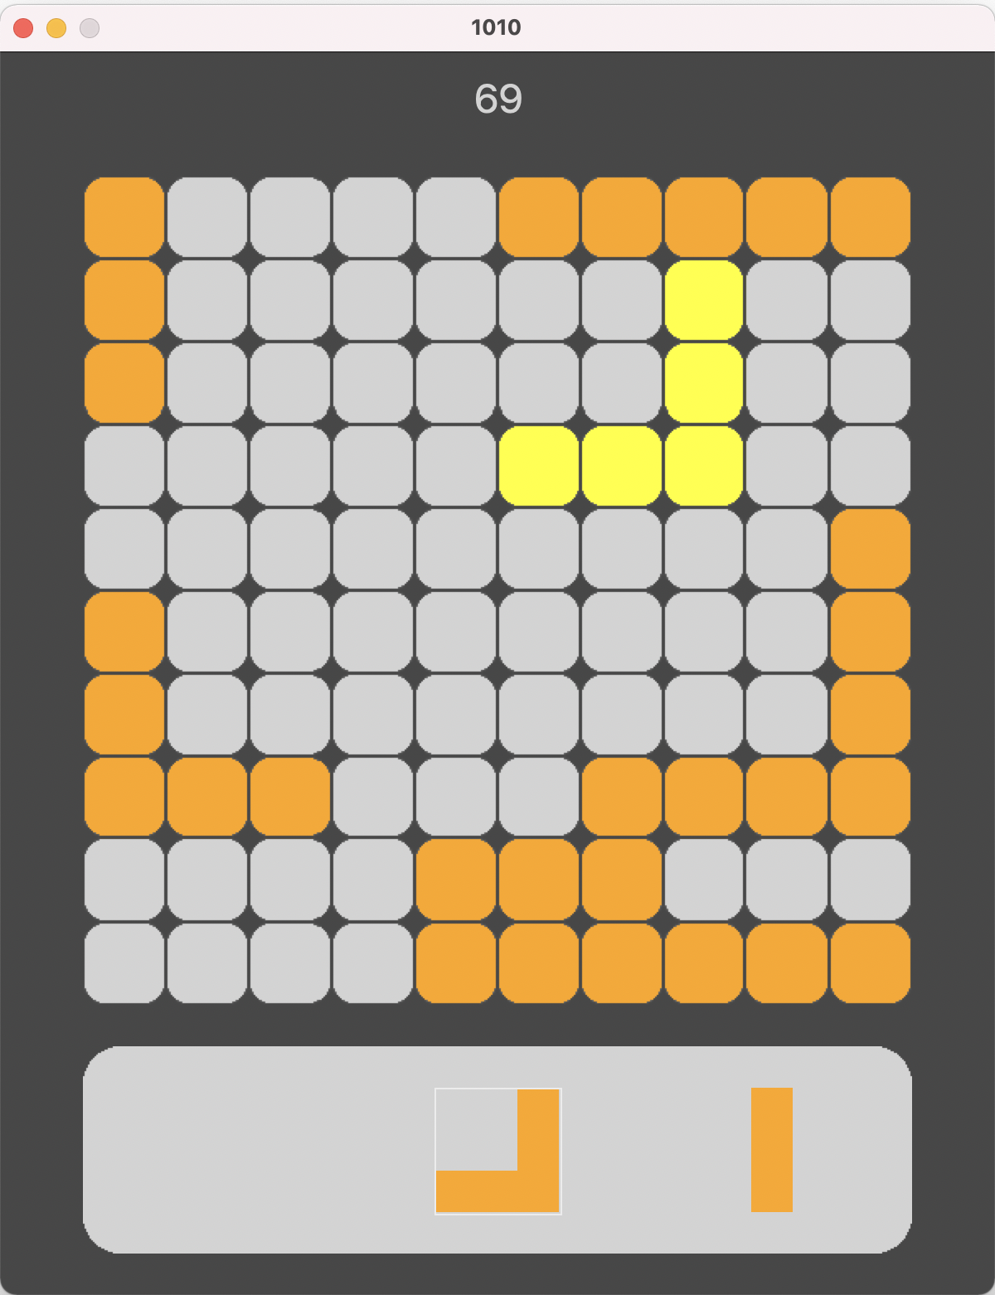
Surface = 6
Surface = 1
VS

Slide 7
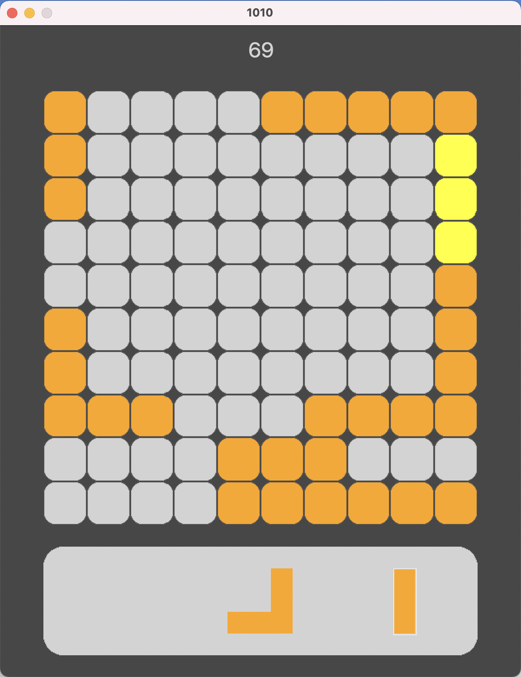
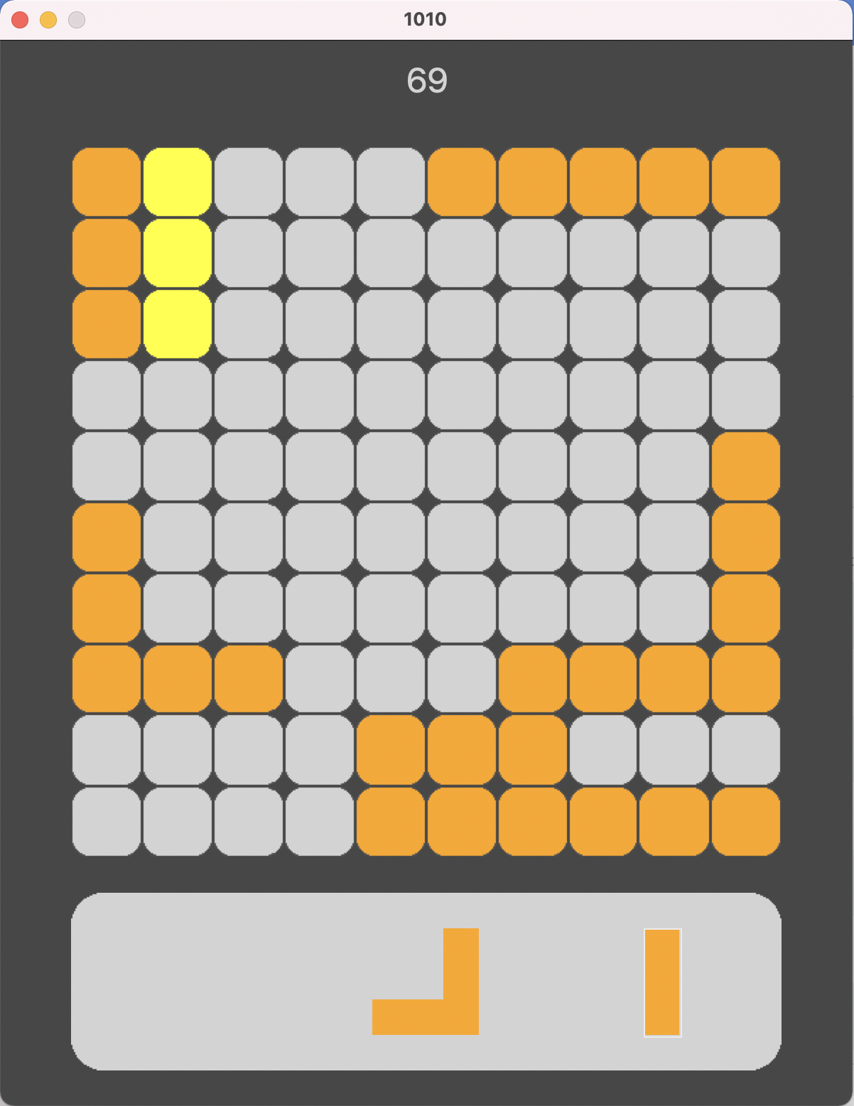
VS

Slide 8
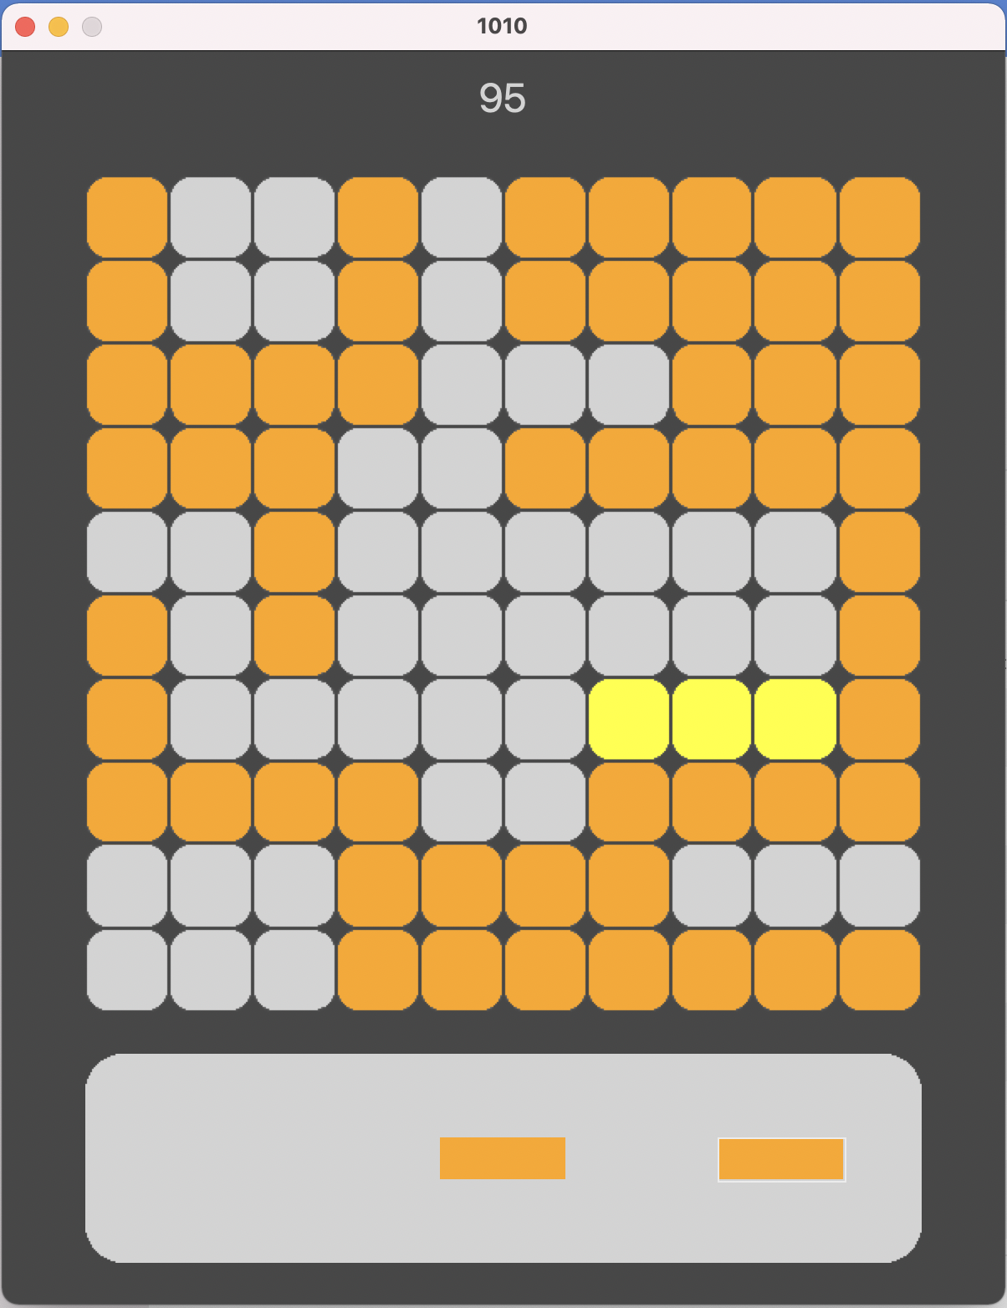
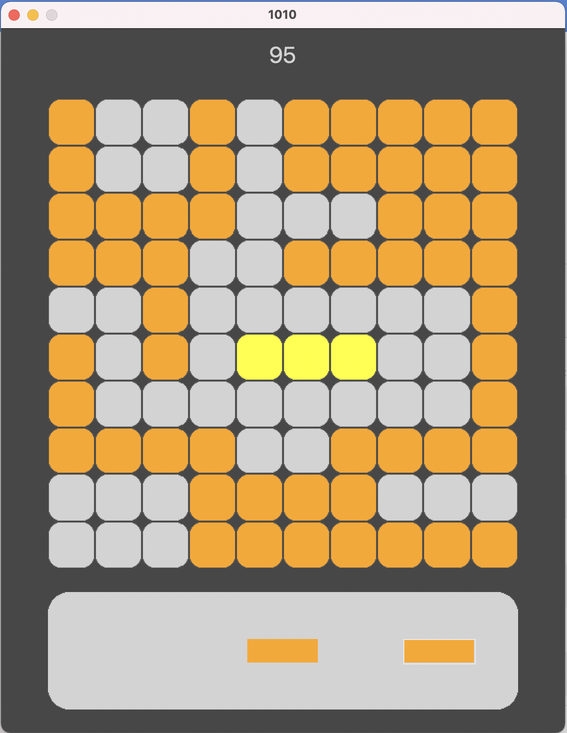
VS

Slide 9
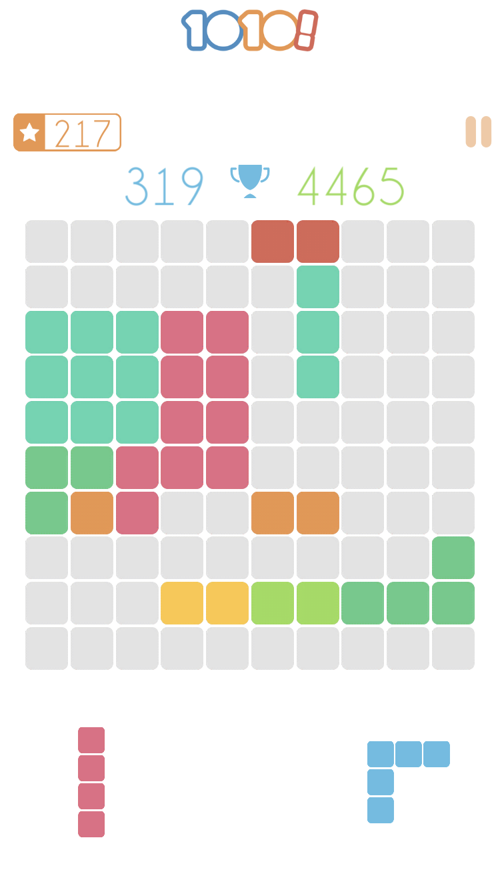
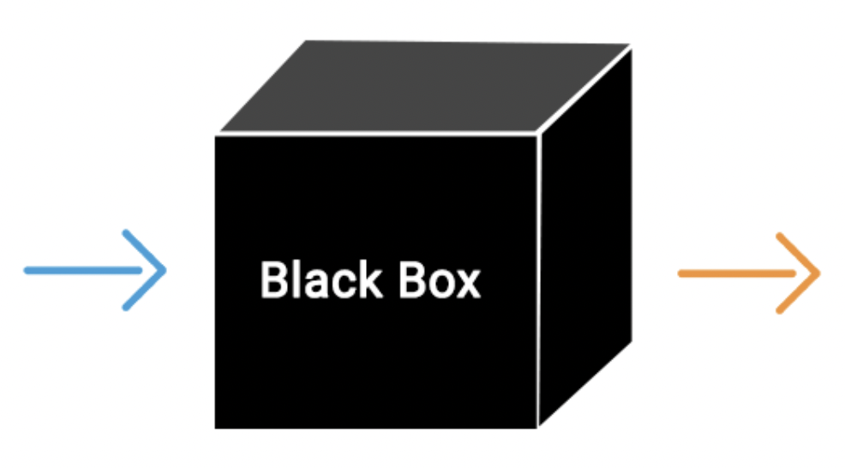
Informed Search
Greedy Best-First Search (single) - action choice is independent for each piece

Slide 10
Informed Search
Greedy Best-First Search (triple) - considers all information about given pieces

Slide 11

Adversarial Search
Alpha Betta

Slide 14
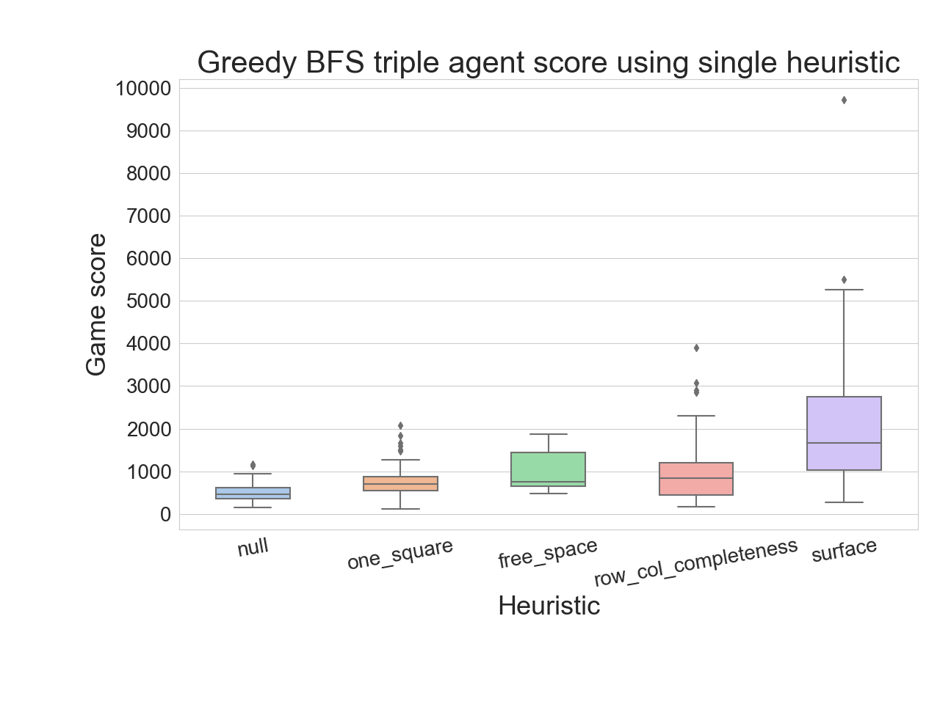

Slide 15
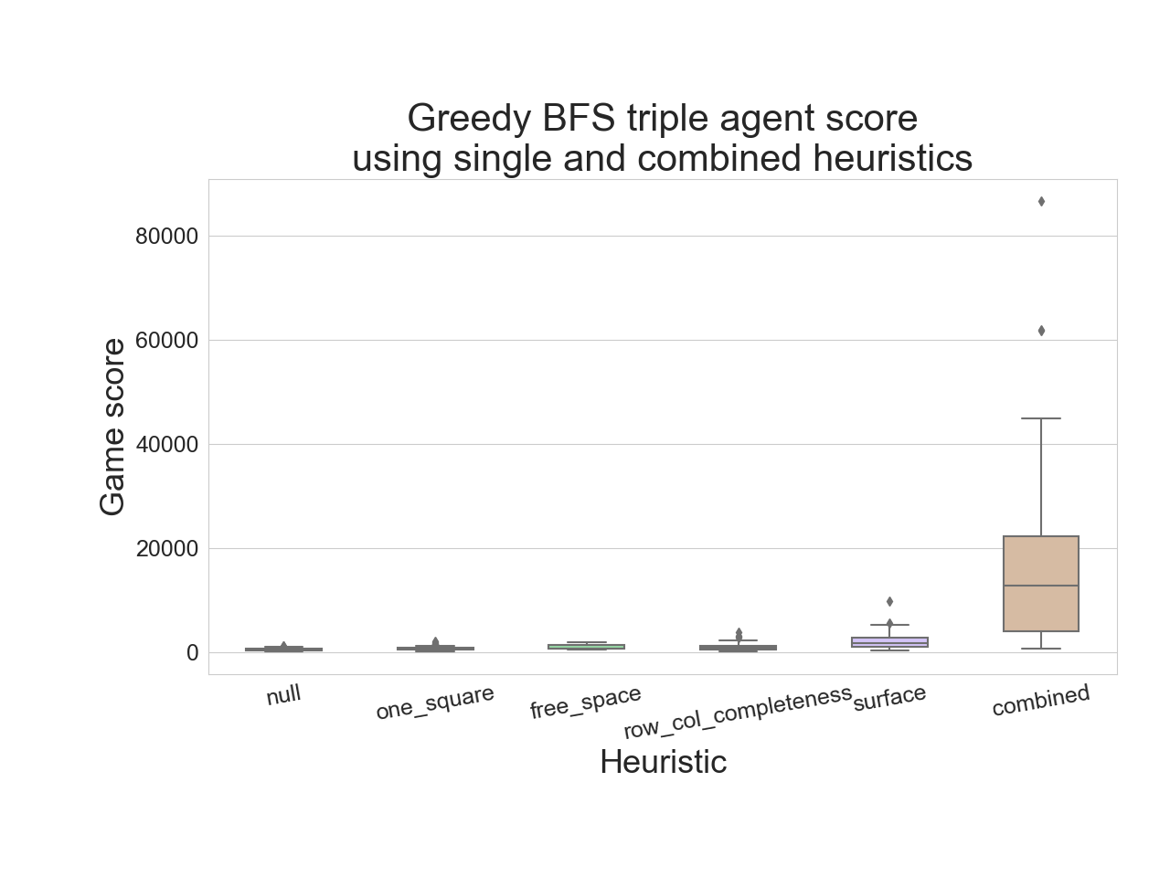

Slide 17
